Slide 1
Analyzing California’s Industry Landscape
Presented By:
Victoria Capobianco
Karen Tafa
John Lehne
May 6, 2021

Slide 2
Agenda:
Intro
Research Question-John
ACS-Victoria
Data
Race Data Tables
Education Data Tables
Industry Data Tables
III. Visuals
IV. Insights & Takeaways

Slide 3
Research Question & Relevance
Which industries are dominated by certain demographics of people?
Is a certain industry male or female dominated?
Are there certain education levels tied to specific industries?
What is the relationship between race and the professional landscape?
Answering this question provides stronger insights into an evolving workplace
Notes:
Which industries are dominated by certain demographics of people?
Is a certain industry male or female dominated?
Are there more young people in tech positions?
Which races tend to hold certain occupations or have jobs in specific industries?
Answering this question provides stronger insights into an evolving workplace
Aids many of us who are preparing to find new careers after graduation
Helps understand the push towards more equality in hiring practices
Where there still needs to be change
Which industries are showcasing diverse and equal hiring

Slide 4
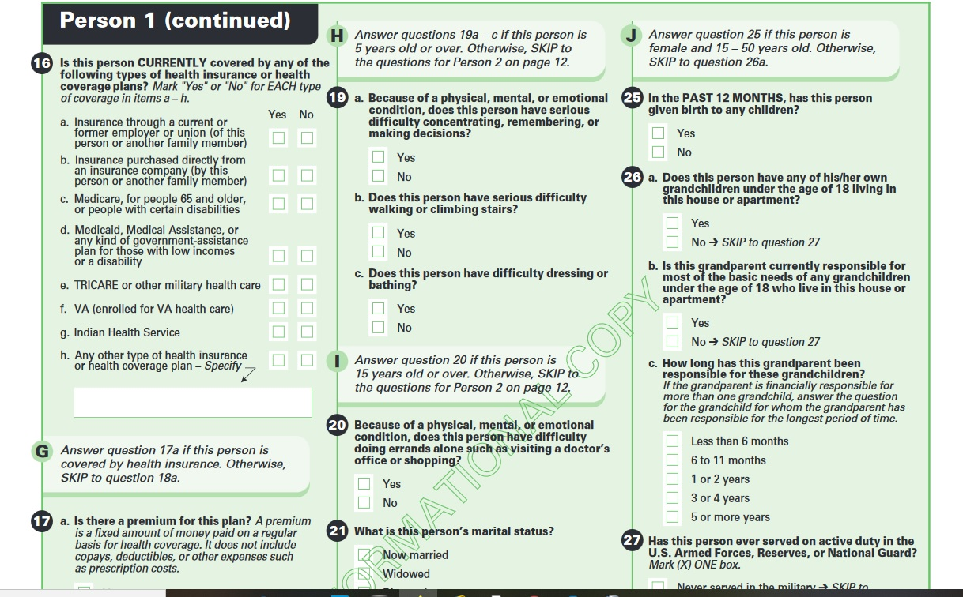
Data Source
American Community Survey
Audience: Government & local public officials
Aid in present & future community planning
Population Variables
Educational Attainment
Earnings & Income
Industry & Occupation
Race
Sex

Slide 5
Income by Race Tables
Table B19301: Per Capita Income by Race
White
Black
Asian
Native Hawaiian Pacific Islander
Indian Native Alaskan Native
Hispanic
Other
Analyze Trend over 5 years (2015-2019)
Filtered to County Level
Conducted 35 table joins in Excel

Slide 6
Education Attainment Tables
Education Attainment by Age and Race
displays the type of education attained by different age groups and races by Zip Code
It contains 5 years of data (2015-2019)
Data Cleaning in Python
removed repetitive columns, renamed columns,
checked for null values & duplicates
created calculated fields in Tableau

Slide 7
Industry and Median Earnings Tables
Industry Table
Outlines the population by industry and then breaks down the percentage of the population by occupation
Median Earnings Table
Outlines the median earnings of each gender by industry
Data Cleaning
Deleting columns, rename columns, check data types, clean extra characters, manage null values

Slide 8
Visualizations

Slide 9
Surprising Takeaways
People are very concentrated in the Bay Area & Los Angeles
The Income differences due to Education attainments are clear cut
Female Earnings less than Male
Discrepancy in Income by Race

Slide 10
Project Takeaways
Limitations:
Missing Data
ACS takes a long time to process survey responses
Data is not as up-to-date as it could be
Benefits:
Our insights are strong jumping off point for further research
Basic analytics go a long way!

Slide 11
Thank You!!
Questions?

